Slide 1
Hough Transform

Slide 2
Hough Transform
Hough transform is most commonly used for the detection of regular curves such as lines, circles, ellipses, etc.
The main advantage of the Hough transform technique is that it is tolerant of gaps in feature boundary descriptions and is relatively unaffected by image noise.

Slide 3
Straight Line
We will use the Hough transform to fit the equation of a straight line to the edge points.
The equation of a line is given by
  y= mx+c (1)
  where m and c are the slope and y is the intercept of the line
The above equation can be rewritten
  c= (-x)m+y
  This is the equation of a line in c-m space with slope -x and intercept y. Therefore a point x,y in the x-y space is mapped to a straight line in the c-m space.

Slide 4
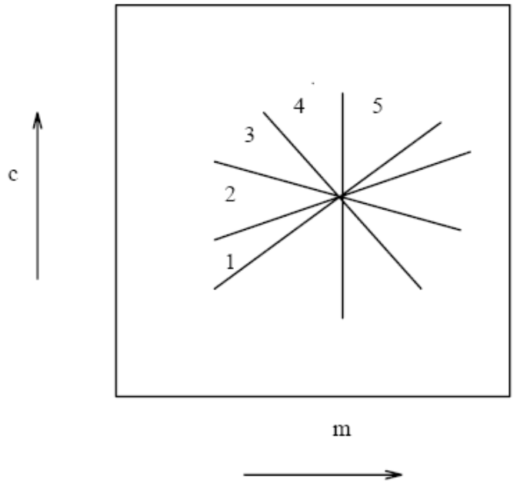
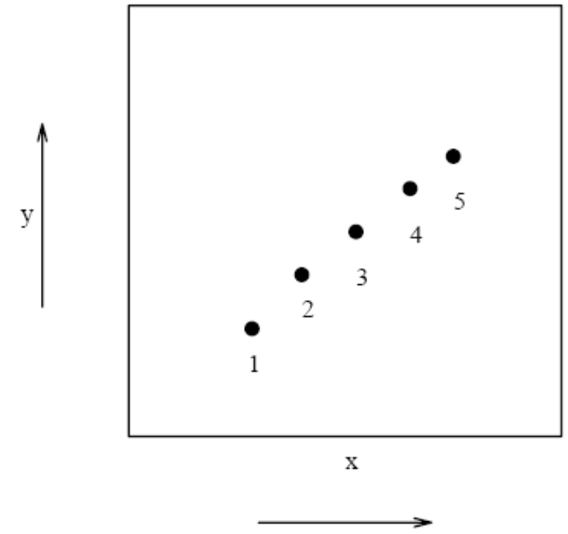
Fitting line using the Hough transform
  (1) Points in x-y space
  (2) Lines in c-m space corresponding to points in x-y space
  The lines intersect at a single point

Slide 5
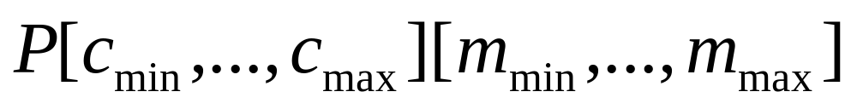
Hough transform algorithm for fitting straight lines
Quantize the parameter space
For each edge point (x,y) do
for(m = m_{min}, m<=m_{max}; m++){
  C = (-x)m+y;
  P[c][m]++;
  }
3. Find the local maxima in the parameter space

Slide 6
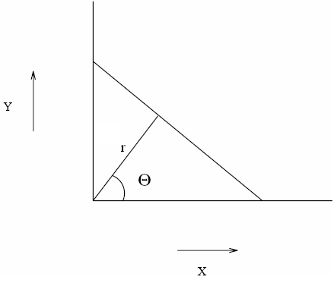
The parameterization of a line given in equation (1) has one problem. The line parallel to y-axis has infinite slope m which can not be represented by a computer.
Another parameterization of a line
  r= x cos(θ)+y sin(θ)
Another advantage of using this parameterization is that can be computed θ from the gradient angle during the edge detection
  Therefore instead of looping through all possible values of θ we can just use
  the from the gradient angle

Slide 7
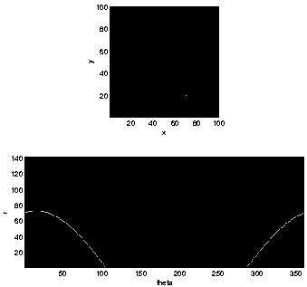
One point in (x,y)-space maps to a curve in (r, θ)-space

Slide 8

Two points map to two curves in (r, θ)-space

Slide 9
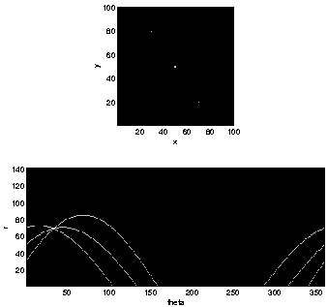
The corresponding curves in (r, θ)-space of three collinear points share a common point of intersection.
See hough1.m

Slide 10
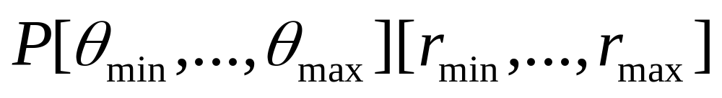
Hough transform algorithm using polar form of equation of straight line
Quantize the parameter space
For each edge point (x,y) do
  r= x cos(θ)+y sin(θ)
  P[θ,r]++
3. Find the local maxima in the parameter space

Slide 11
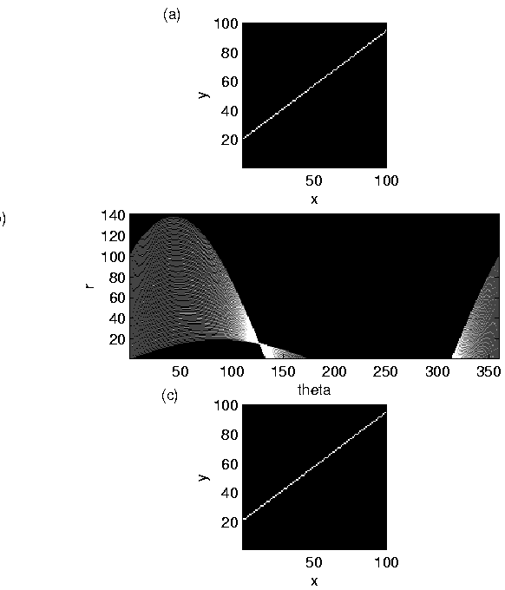
Input image.
Image of the accumulator array.
Image of the reconstructed line.
See hough2.m

Slide 12
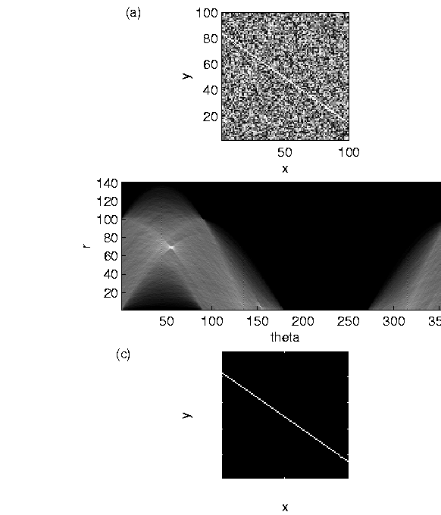
Two lines in a noisy image

Slide 13
See hough3.m
The noisy image was constructed with two lines, one of gradient m=2.0 and y-intercept b=10.0, and the other line of gradient m=-0.7 and y-intercept b=85.0.
Rather than finding feature points, the program implemented the Hough transform on all points in the image.
It should be noted that the Hough transform will only find the longest line in the image.
To detect the second line in the image, the program would have to locate the second local maxima in the accumulator array.

Slide 14
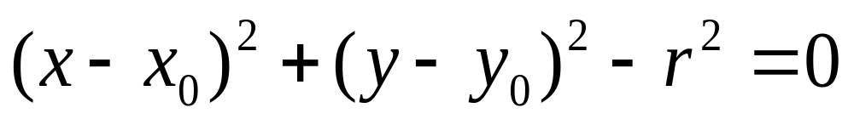
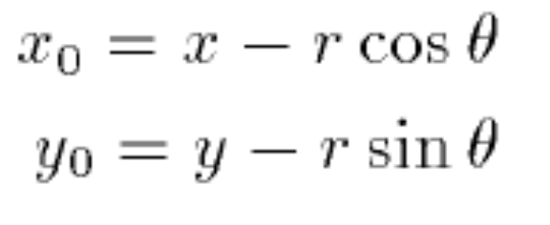
Circle
The equation of a circle centered at x₀, y₀ with radius r is given by:
In this case we have three unknowns x₀, y₀, r
  Therefore the parameter space is three dimensional
The gradient angle information can be used to reduce the computational complexity
Another parameterization of a circle is given by

Slide 15
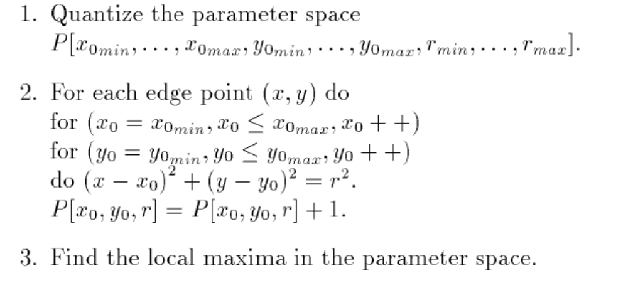
Hough transform algorithm for fitting circle

Slide 16
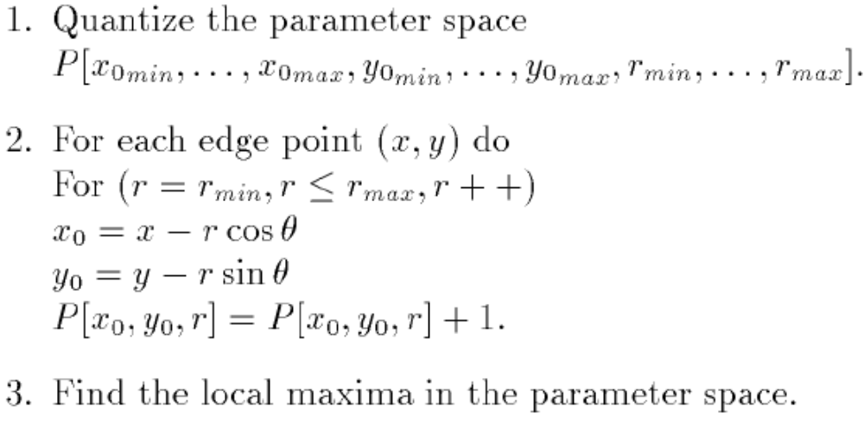
Hough transform algorithm for fitting circle using polar form of equation of a circle

Slide 17
**Presentation Assignment
Examples!
[H, theta, rho] = hough(bw)
lines = houghlines(BW, theta, rho, peaks)
peaks = houghpeaks(H,numpeaks)

